Slide 1

Data Fundamentals for Business Analysis
Understanding Data as a Business Asset, Data Cleaning, and Visualization
Introduction

Slide 2
Introduction
Data is the backbone of modern business decision-making.
With the increasing availability of data, businesses rely on data-driven insights to:
Optimize operations
Improve customer experience
Gain competitive advantages
This session will explore:
The role of data as a business asset
Data collection and cleaning techniques
Data visualization tools
Hands-on exercises included to reinforce key concepts.
Data as a Business Asset

Slide 3

Data as a Business Asset

Slide 4
Importance of Data in Decision-Making
Businesses collect data from various sources:
Customer interactions
Financial transactions
Social media
POS machines
CRM & E-commerce platforms
IoT Sensors
Government & Public Data

Slide 5
Benefits of Data Analysis
Identifying customer preferences
Improving operational efficiency
Enhancing marketing strategies
Managing risks effectively
Forecasting sales and market trends

Slide 6

Examples of Data-Driven Decision-Making

Slide 7
Some famous quotes
"Without data, you're just another person with an opinion." – W. Edwards Deming
"Data is the new oil." – Clive Humby
"In God we trust, all others must bring data." – W. Edwards Deming
"Data beats emotions." – Sean Rad, Co-founder of Tinder
"Torture the data, and it will confess to anything." – Ronald Coase
"The world’s most valuable resource is no longer oil, but data." – The Economist

Slide 8
Retail Industry
Personalized Recommendations
Uses browsing & purchase history
AI suggests relevant products
Inventory Management
Analyzes sales trends & seasonal demand
Prevents overstock & stockouts
Dynamic Pricing
Adjusts prices based on demand & competitors
Maximizes revenue & competitiveness
Healthcare Industry

Slide 9
Healthcare Industry
Predictive Diagnosis
AI analyses patient history & scans
Detects diseases early
Resource Allocation
Patient inflow data optimizes staff & bed availability
Improves hospital efficiency
Personalized Treatment
Uses patient history & genetics
Tailors treatment for better outcomes
Finance & Banking

Slide 10
Finance & Banking
Fraud Detection
AI monitors transaction patterns
Flags unusual activity
Credit Scoring
Assesses creditworthiness using financial history
Reduces lending risks
Automated Trading
AI-driven models analyse market trends
Executes trades with minimal human intervention
Manufacturing & Supply Chain

Slide 11
Manufacturing & Supply Chain
Predictive Maintenance
IoT sensors detect machine failures early
Reduces downtime & repair costs
Supply Chain Optimization
Data-driven logistics improve delivery efficiency
Cuts transportation costs
Quality Control
AI-powered image recognition detects defects
Ensures product consistency
Marketing & Advertising

Slide 12
Marketing & Advertising
Targeted Advertising
Analyses user behaviour for personalized ads
Improves engagement & conversions
Campaign Performance Analysis
Tracks ad performance in real-time
Optimizes marketing spend
Customer Sentiment Analysis
Monitors reviews & social media feedback
Enhances brand strategy
Education & E-Learning

Slide 13
Education & E-Learning
Adaptive Learning Platforms
AI customizes learning paths
Boosts student engagement
Dropout Prediction
Analyses attendance & performance
Enables early intervention
Personalized Tutoring
Recommends study materials based on learning patterns
Improves academic outcomes
Data Collection and Cleaning

Slide 14

Data Collection and Cleaning
Data Collection overview

Slide 15
Data Collection overview
What is Data Collection? The process of: ✅ Gathering ✅ Measuring ✅ Analysing information from various sources
Why is it Important? Helps businesses with: 📌 Customer Behaviour Analysis 📌 Trend Forecasting 📌 Inventory Management 📌 Performance Evaluation
Basic Data Collection Techniques
Primary Data Collection Methods

Slide 16

Basic Data Collection Techniques
Basic Data Collection Techniques
Primary Data Collection Methods
Survey & Questionnaires
Interviews
Observations
Focus Groups
Secondary Data Collection Methods

Slide 17

Basic Data Collection Techniques
Basic Data Cleaning Techniques
Secondary Data Collection Methods
Company Records & Internal Databases
Government Reports & Public Data
Industry Reports & Market Research
Social Media & Web Analytics
Web Scraping & APIs
Handling Missing Data
Removing Duplicates
Correcting Inconsistent Data
Handling Outliers
Data Type Conversion

Slide 18

Basic Data Cleaning Techniques
Handling Missing Data
Removing Duplicates
Correcting Inconsistent Data
Handling Outliers
Data Type Conversion
Handling Missing Data

Slide 19

Handling Missing Data
Methods:
Deletion
Imputation (Mean/Median/Mode)
Forward/Backward Fill
Example:
Imagine a cycle store’s sales dataset has missing values in the "Sales Amount" column. If these missing values are ignored during total revenue calculations, the revenue report will be inaccurate, leading to incorrect business decisions.
Removing Duplicates

Slide 20

Removing Duplicates
Methods:
Identify duplicates using a combination of fields.
Use Excel functions or Pandas drop_duplicates().
Example:
A stationery store generates a monthly sales report, but due to a system error, some transactions are recorded twice. If duplicates are not removed, the revenue appears higher than reality, leading to misleading financial reports.
Correcting Inconsistent Data

Slide 21

Correcting Inconsistent Data
Methods:
Standardizing Formats
Text Standardization
Category Matching
Example:
A cycle store records customer regions as "North", "NORTH", and "N" in different places. When analysing regional sales, these variations cause the store to underestimate or overestimate sales from certain regions.
Handling Outliers

Slide 22

Handling Outliers
Methods:
Visualization- Use box plots & scatter plots.
Statistical Methods- Apply Z-score or IQR methods.
Capping or Removing- Transform extreme values to the nearest acceptable value or remove them.
Example:
A cycle store’s profit report shows that one order generated $50,000 in revenue, whereas the average is only $500. Upon investigation, this was due to a data entry mistake where the quantity was incorrectly entered as 1,000 instead of 10. If not corrected, this misleading data point can affect revenue forecasting.
Data Type Conversion

Slide 23

Data Type Conversion
Key Takeaways
Methods:
Convert numeric columns to integers or floats.
Ensure date columns are recognized as date-time objects.
Convert categorical data into appropriate text or coded formats.
Example:
A cycle store’s sales dataset stores "Price Per Unit" as text instead of numeric values. When the store attempts to calculate total sales (Quantity Sold * Price Per Unit), it results in an error or incorrect calculations, leading to flawed business insights.

Slide 24

Key Takeaways
Clean data reduces errors and enhances data-driven decision-making.
Inconsistencies and duplicates can mislead analysis and impact business strategy.
Handling outliers prevents distorted reports and inaccurate forecasts.
Data type conversion ensures correct calculations and processing.
Exercise

Slide 25

Exercise
Case Study - Pen & Paper Supplies

Slide 26

Case Study - Pen & Paper Supplies
Background A local stationery store, Pen & Paper Supplies, has been operating for the past two years. They recently expanded their product line and customer base, leading to a surge in sales. To optimize their inventory and pricing strategy, the store owner, Sarah, decided to analyse sales data. However, when she received the dataset, she noticed several issues such as missing values, duplicate entries, and inconsistent formatting.
Problem Statement

Slide 27

Problem Statement
Data Cleaning Process
Sarah faced challenges while generating reports due to:
Missing product names and customer details.
Duplicate order records inflating sales numbers.
Inconsistent date formats making time-based trend analysis difficult.
Different text capitalizations leading to classification errors.

Slide 28

Data Cleaning Process
To ensure accurate analysis, Sarah’s team performed the following steps:
Handling Missing Data
Removing Duplicates
Standardizing Formats
Data Validation
Outcome

Slide 29
Outcome
Key takeaways
After cleaning the data, Sarah’s team was able to generate reliable reports, identify best-selling products, adjust pricing strategies, and forecast demand accurately.
This led to
Increase in revenue
Better stock management.

Slide 30

Key takeaways
Data quality impacts business decisions.
Cleaning data improves accuracy and efficiency.
Standardization ensures consistency in reporting.
By implementing proper data cleaning techniques, businesses like Pen & Paper Supplies can make informed decisions and enhance their overall performance.
Data Visualization

Slide 31

Data Visualization

Slide 32
Introduction to Data Visualization Tools
MS EXCEL
TABLEAU PUBLIC
LOOKER
POWER BI
PYTHON LIBRARIES (PLOTLY, MATPLOTLIB,SEABORN)
MS EXCEL
TABLEAU PUBLIC
LOOKER
POWER BI
PYTHON LIBRARIES (PLOTLY, MATPLOTLIB,SEABORN)

Slide 33
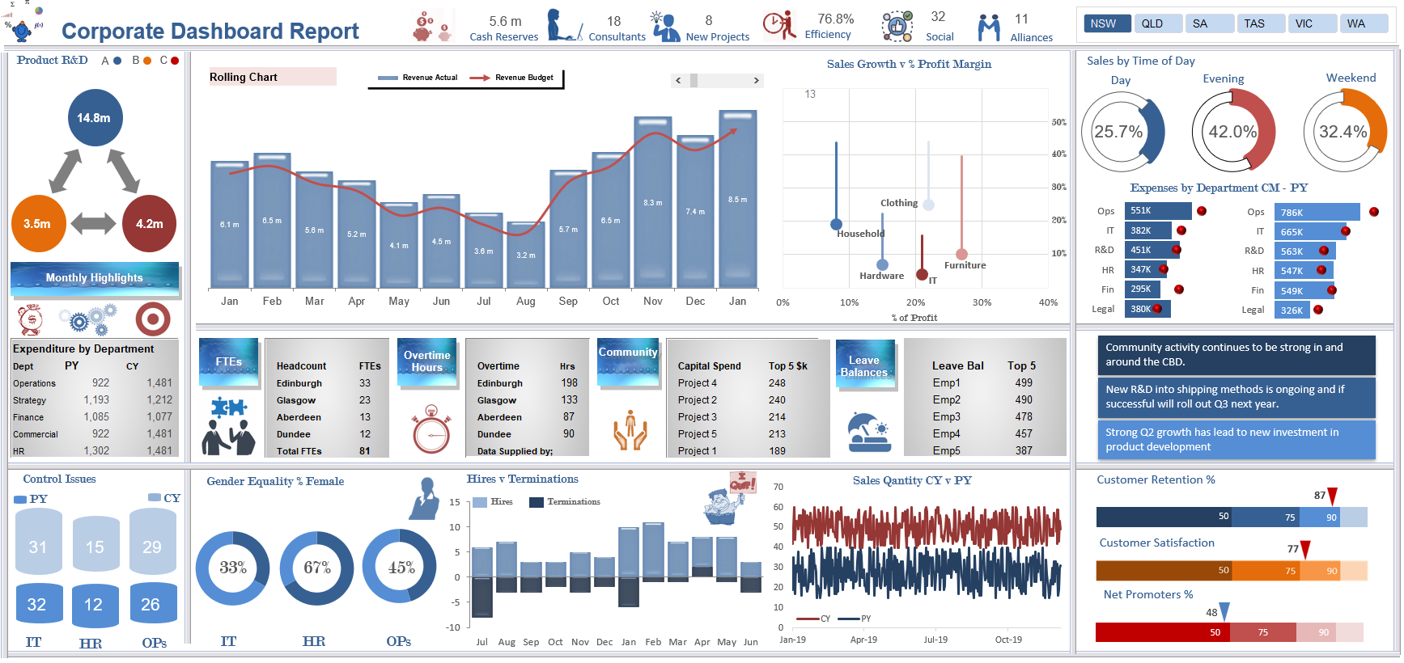
MS EXCEL
MS EXCEL
TABLEAU PUBLIC
LOOKER
POWER BI
PYTHON LIBRARIES (PLOTLY, MATPLOTLIB,SEABORN)
Advantages:
Widely available and easy to use.
Simple charts and graphs for quick analysis.
Integration with Microsoft Office for seamless reporting.
Pivot tables and conditional formatting enhance visual insights.
Disadvantages:
Limited advanced visualization capabilities.
Not ideal for handling large datasets efficiently.
No interactive dashboards.
Performance issues with complex visualizations.

Slide 34
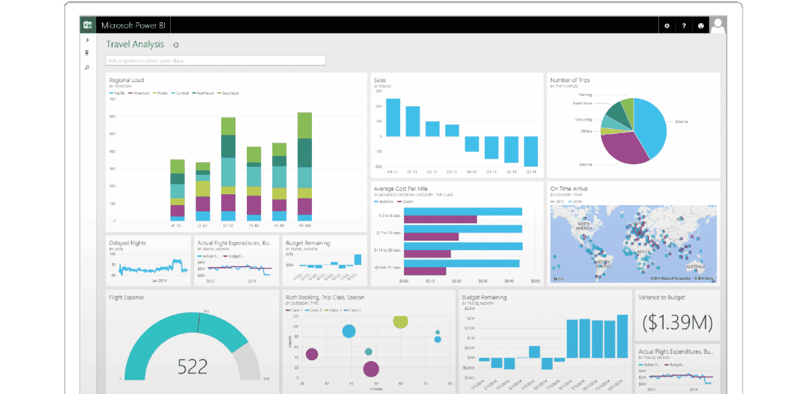
POWER BI
Advantages:
Strong integration with Microsoft ecosystem.
Interactive dashboards and real-time data visualization.
AI-powered insights and advanced DAX calculations.
Handles large datasets efficiently.
Disadvantages:
Requires Power BI Pro for sharing reports.
Steeper learning curve for advanced features.
Less customization compared to Tableau.
Cloud dependency for full functionality.

Slide 35
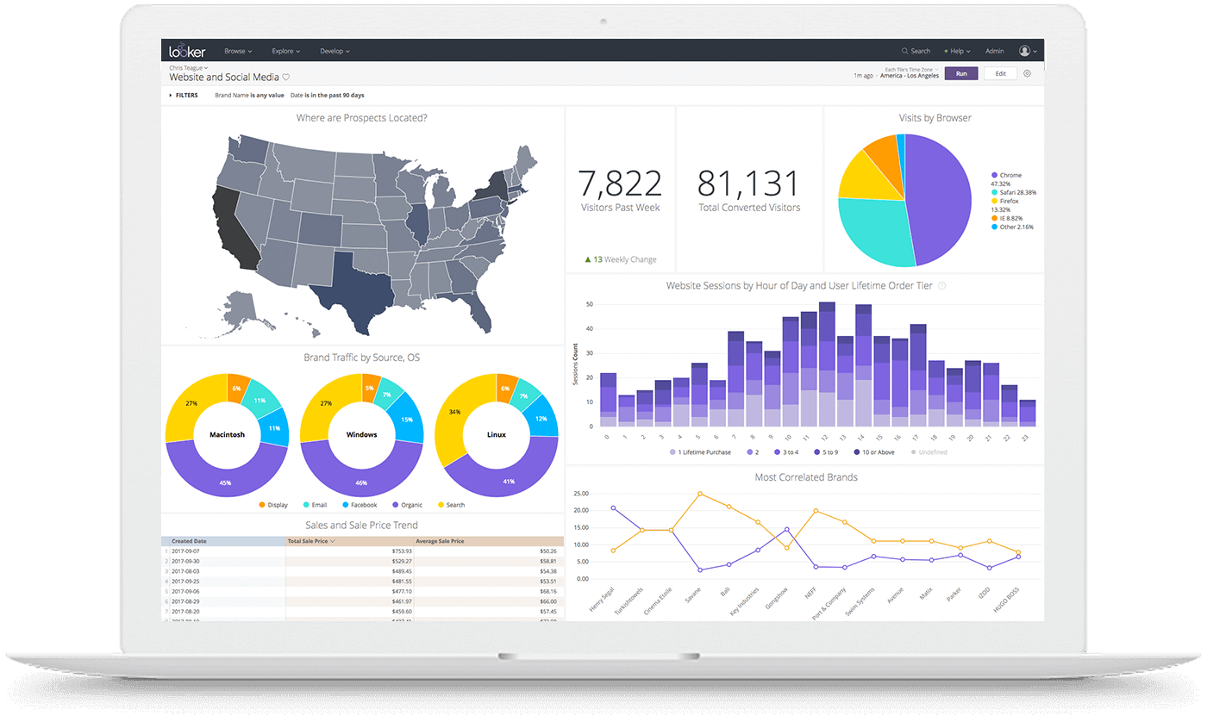
Looker
MS EXCEL
TABLEAU PUBLIC
LOOKER
POWER BI
PYTHON LIBRARIES (PLOTLY, MATPLOTLIB,SEABORN)
Advantages:
Cloud-based with strong Google Cloud integration.
Disadvantages:
Steep learning curve due to LookML.
Strong data governance and security.
Advanced SQL-based modeling (LookML) for customization.
Interactive and collaborative reporting.
Expensive compared to other BI tools.
Limited offline capabilities.
Less intuitive compared to Power BI and Tableau.

Slide 36
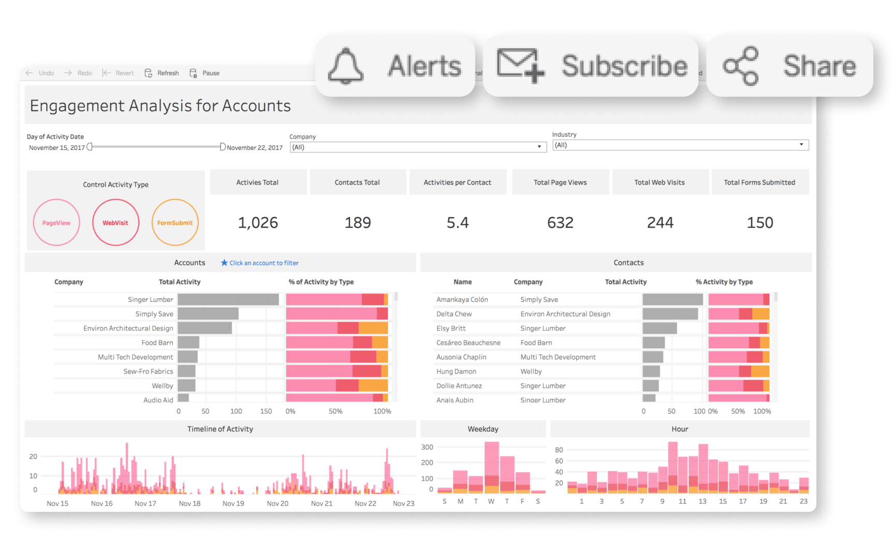
TABLEAU
Advantages:
Highly interactive and customizable visualizations.
Disadvantages:
Expensive licensing model.
Drag-and-drop functionality for ease of use.
Strong support for real-time data and multiple data sources.
Advanced analytics and AI-driven insights.
Requires training for advanced functionality.
Performance issues with very large datasets.
Less seamless integration with Microsoft products compared to Power BI.

Slide 37
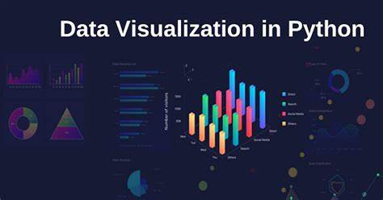
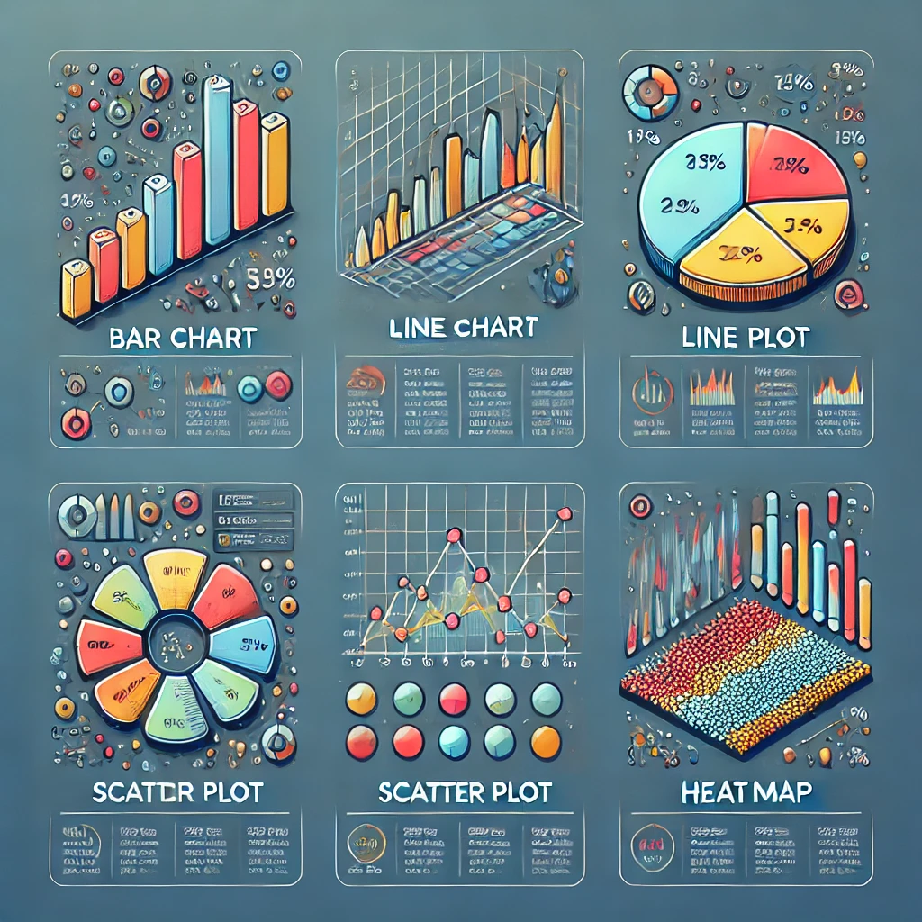
PYTHON LIBRARIES (PLOTLY, MATPLOTLIB,SEABORN)
MS EXCEL
TABLEAU PUBLIC
LOOKER
POWER BI
PYTHON LIBRARIES (PLOTLY, MATPLOTLIB,SEABORN)
Advantages:
Highly customizable for complex data visualization.
Disadvantages:
Requires programming knowledge (Python).
Open-source and free.
Supports interactive and static visualizations.
Suitable for advanced analytics and machine learning.
No built-in drag-and-drop functionality.
Not as user-friendly as BI tools.
Requires additional libraries for dashboarding (e.g., Dash for Plotly).

Slide 38
Types of Data Visualizations
BAR CHARTS
LINE CHARTS
PIE CHARTS
SCATTER PLOTS
HEATMAPS

Slide 39
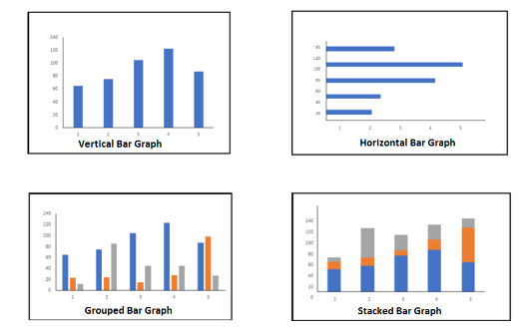
Bar charts
Sales Performance Analysis: Compare monthly or yearly sales across different products or regions.
Market Share Comparison: Visualize the share of different companies in an industry.
Survey Results: Display categorical data such as customer preferences or demographics.
Budget vs. Actual Spending: Compare planned and actual expenditures.
Employee Performance: Compare productivity levels across teams or departments.
BAR CHARTS
LINE CHARTS
PIE CHARTS
SCATTER PLOTS
HEATMAPS

Slide 40
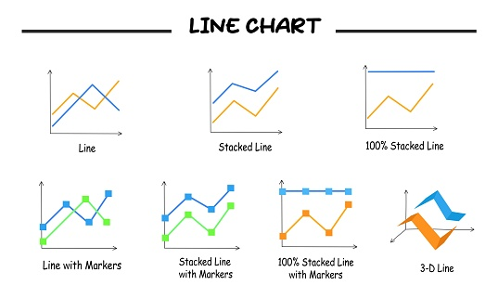
Line charts
Stock Market Trends: Show price changes over time.
Website Traffic Analysis: Display daily or monthly visitor trends.
Sales Growth Over Time: Monitor revenue growth patterns.
Weather Trends: Track temperature variations over a period.
Customer Retention Rates: Show how customer engagement changes over time.

Slide 41
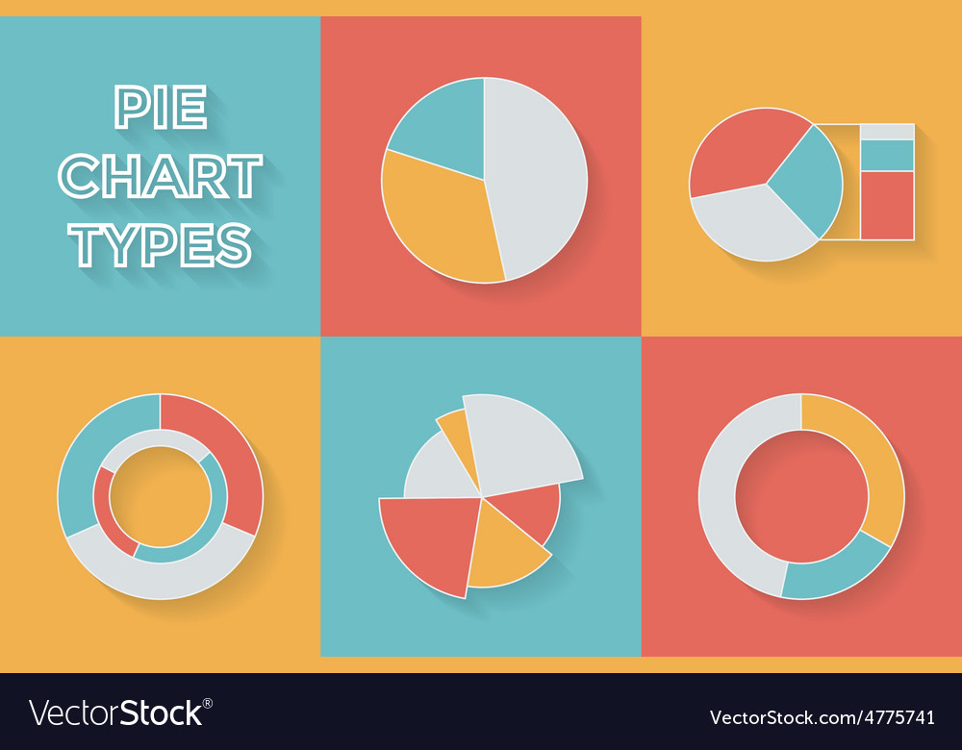
PIE charts
Market Share Representation: Show the percentage of different companies in a sector.
Expense Breakdown: Visualize spending categories in a budget.
Demographic Analysis: Display the distribution of age groups or genders.
Product Category Contribution: Show how different product types contribute to total sales.
Survey Responses: Represent percentage-based responses from customer feedback.
BAR CHARTS
LINE CHARTS
PIE CHARTS
SCATTER PLOTS
HEATMAPS

Slide 42
SCATTER PLOTS
Correlation Analysis: Show the relationship between two numerical variables (e.g., advertising spend vs. revenue).
Customer Segmentation: Identify clusters of customers based on behavior.
Risk Assessment: Plot credit score vs. default probability.
Scientific Research: Analyze patterns in experimental data.
Real Estate Pricing: Compare house prices to square footage.

Slide 43
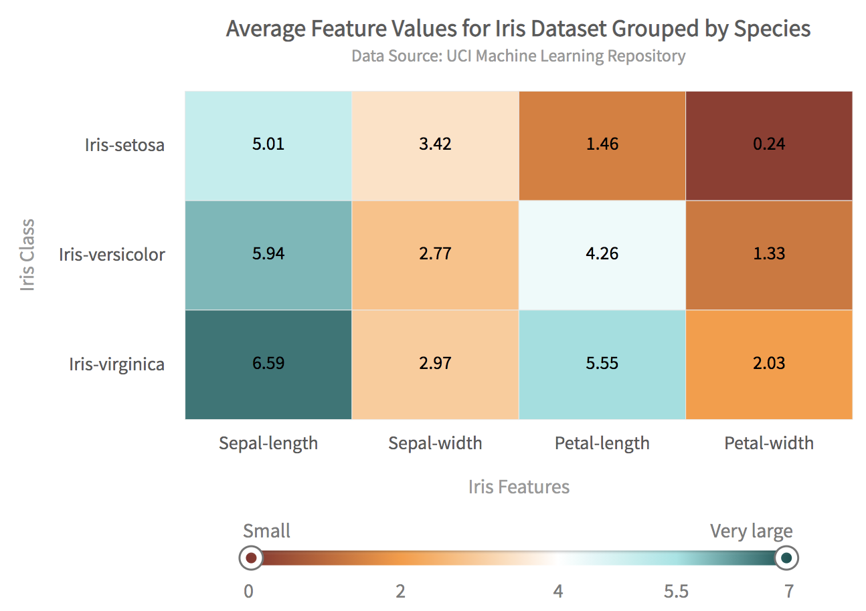
HEATMAPS
Website Click Analysis: Identify high-traffic areas on a webpage.
Sales Performance by Region: Show variations in sales across different geographies.
Stock Market Volatility: Visualize price fluctuations over time.
Hospital Resource Utilization: Track occupancy rates of different hospital departments.
Customer Behavior Analytics: Display heatmaps for customer purchase patterns.
BAR CHARTS
LINE CHARTS
PIE CHARTS
SCATTER PLOTS
HEATMAPS

Slide 44

Hands-On Exercise - Data Cleaning & Visualization
Case Study - Speedy Wheels Cycle Store

Slide 45

Case Study - Speedy Wheels Cycle Store
Background A regional cycle store, Speedy Wheels, has been experiencing a decrease in sales over the past year. To improve its decision-making process, the store’s manager, John, decided to analyse the store’s sales performance data. However, the dataset provided several challenges due to data inconsistencies and quality issues.
Problem statement

Slide 46

Problem statement
John encountered several obstacles when analysing the data, including:
Inconsistent date and time formats, making it difficult to track peak sales hours.
Missing sales records, leading to gaps in revenue calculations.
Duplicate transactions distorting sales performance figures.
Non-relevant columns that complicated the analysis process.
Data cleaning process

Slide 47

Data cleaning process
John’s data team implemented the following steps:
Standardizing Date and Time: All records were formatted to include a single column with accurate timestamps.
Handling Missing Data: Missing sales values were either estimated using trends or filled with appropriate placeholders.
Eliminating Duplicates: Repeated transactions were removed to ensure correct revenue calculations.
Filtering Data: Unnecessary columns were identified and excluded to streamline the analysis process.
outcome

Slide 48

outcome
Once cleaned, the dataset allowed John and his team to:
Identify peak sales hours, leading to optimized staffing.
Detect high-performing product categories.
Improve forecasting and inventory management.
Enhance regional sales strategies by understanding customer preferences.
Key takeaways

Slide 49

Key takeaways
Data accuracy is critical for strategic decision-making.
Cleaning data helps prevent misleading insights.
Standardized timestamps enable time-based sales analysis.
By implementing these data cleaning practices, Speedy Wheels successfully improved its sales analysis and boosted revenue by optimizing its operations.

